Slide 1



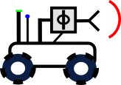

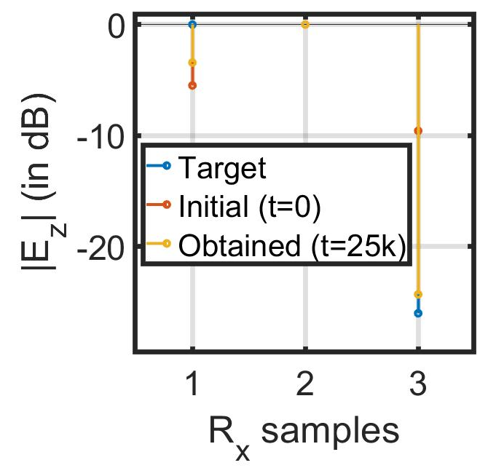
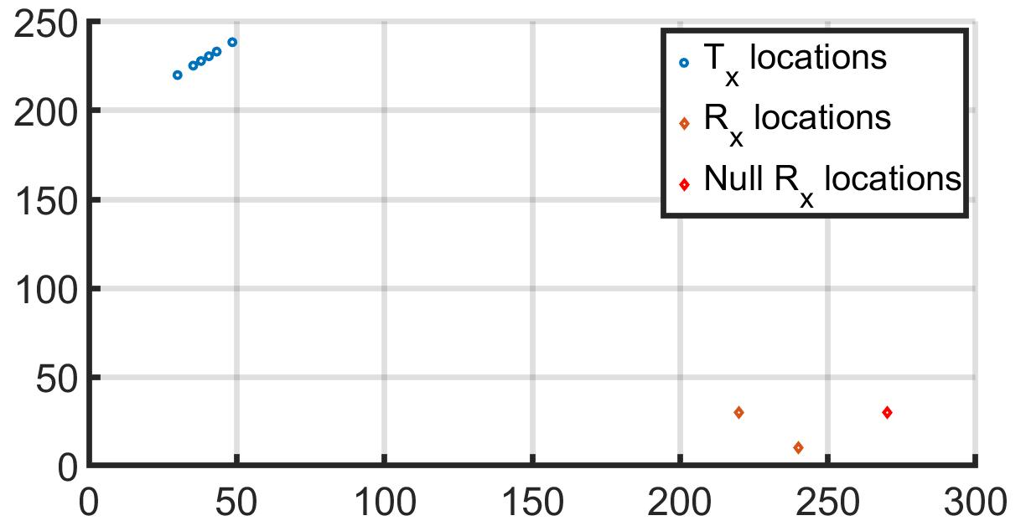

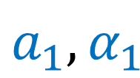
Securing Connected Vehicles, Soldiers, and Platforms in Contested Environments (CRA-4)
This research is supported by U.S. Army Grant No. W911NF2120076
1.6: Distributed Robotic Beamforming
K. Chakrabarti, A. S. Bedi, N. Chopra (UMD),
F. T. Dagefu, J. N. Twigg (ARL)
server
Null Rx
Far-field Rx
$$a_{1},α_{1}$$
$$a_{m},α_{m}$$
IPG-DB
Tx agents
LA Urban Environment
Controlling Covert Directional Comm.

